Slide 1

Department of Computer Science and Engineering
Internship Seminar(18CSP77)
Title: Payment Gateway Integration
Batch No: 2021_CSE_08
Group No: 06
Guided By: Internship Mentor: Vijetha
Mr. Roopesh Kumar BN Ms.Jhanvi 1KS18CS117
Assistant Professor Web Developer
Dept of CSE, KSIT Rinex Technology

Slide 2
AGENDA
Company Profile
Organization Chart
Internship Objective
Internship Task
Skills Utilized
Internship Impact
Project
Snapshots
Conclusion

Slide 3

COMPANY PROFILE
Rinex Technologies Private Limited is a private company incorporated on 19 January, 2021. It is classified as a private limited company and is located in Dakshina Kannada, Karnataka
Motto and vision of the organization is “create an innovative tomorrow”
Rinex strive to prove that learning stops at nothing and promote upskilling yourself to devise the path to success.

Slide 4
ORGANIZATION CHART
CEO
HN Rohith
Operations Manager
Manoj M
Team Leader
Adarsh Kumar
Director of HR
Heera K
Hiring, Employment & Wages department
IT Manager
Akshay Kumar
IT Analysts
Production Team
Figure 1: Company’s Organization Chart

Slide 5
INTERNSHIP OBJECTIVE
To develop skills and techniques directly applicable to the careers.
To develop skills in the application of theory to practical work situations.
To achieve real-world work experience.

Slide 6
INTERNSHIP TASK
Module 1
Module 2
Module 3
Structuring the web |  | Styling the web | Client-side scripting through payment integration
Structuring the web | Styling the web | Dynamic client side scripting through payment integration | Generating a invoice pdf to donor through email

Slide 7
SKILLS UTILIZED
Creating a Responsive Website which is convenient to both desktop and Mobiles.
Payment Gateway , technology that captures and tranfers payment data from customer to acquirer.

Slide 8
IMPACT
Gained work experience. The hands-on experience received during the internship was very useful.
Identifying areas where my knowledge and experience served as strength.
Gained hands-on experience in building the website.

Slide 9
PROJECT
Project Name : Payment Gateway Integration.
Software Requirements:
Visual Studio Code
Programming Languages:
HTML
CSS
JavaScript

Slide 10

SNAPSHOTS
Home Page:

Slide 11
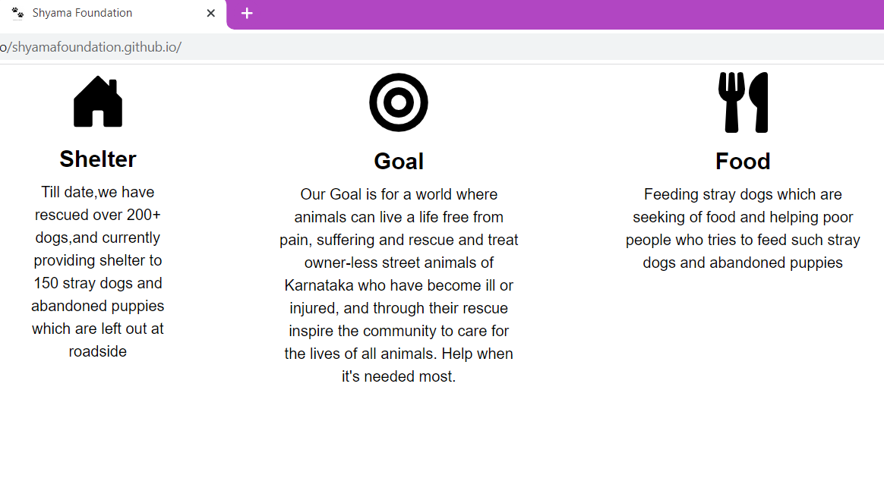
SNAPSHOTS

Slide 12
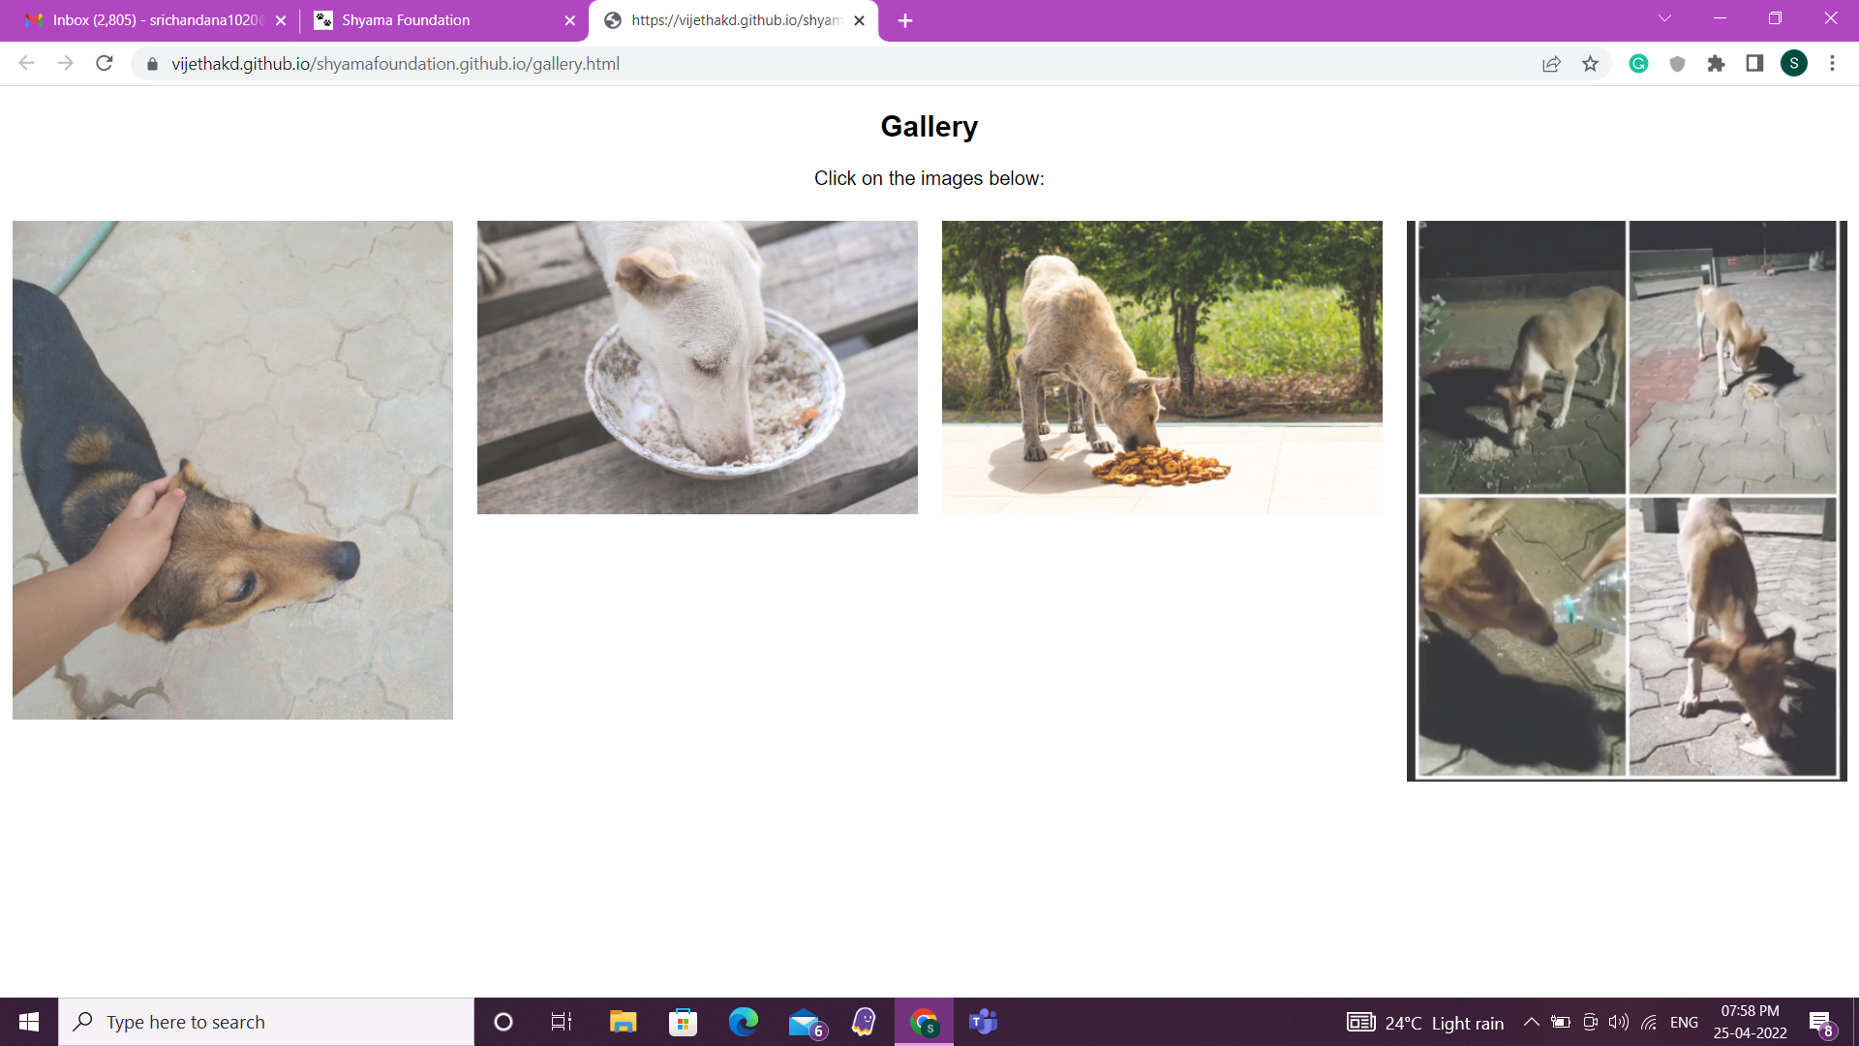
SNAPSHOTS

Slide 13
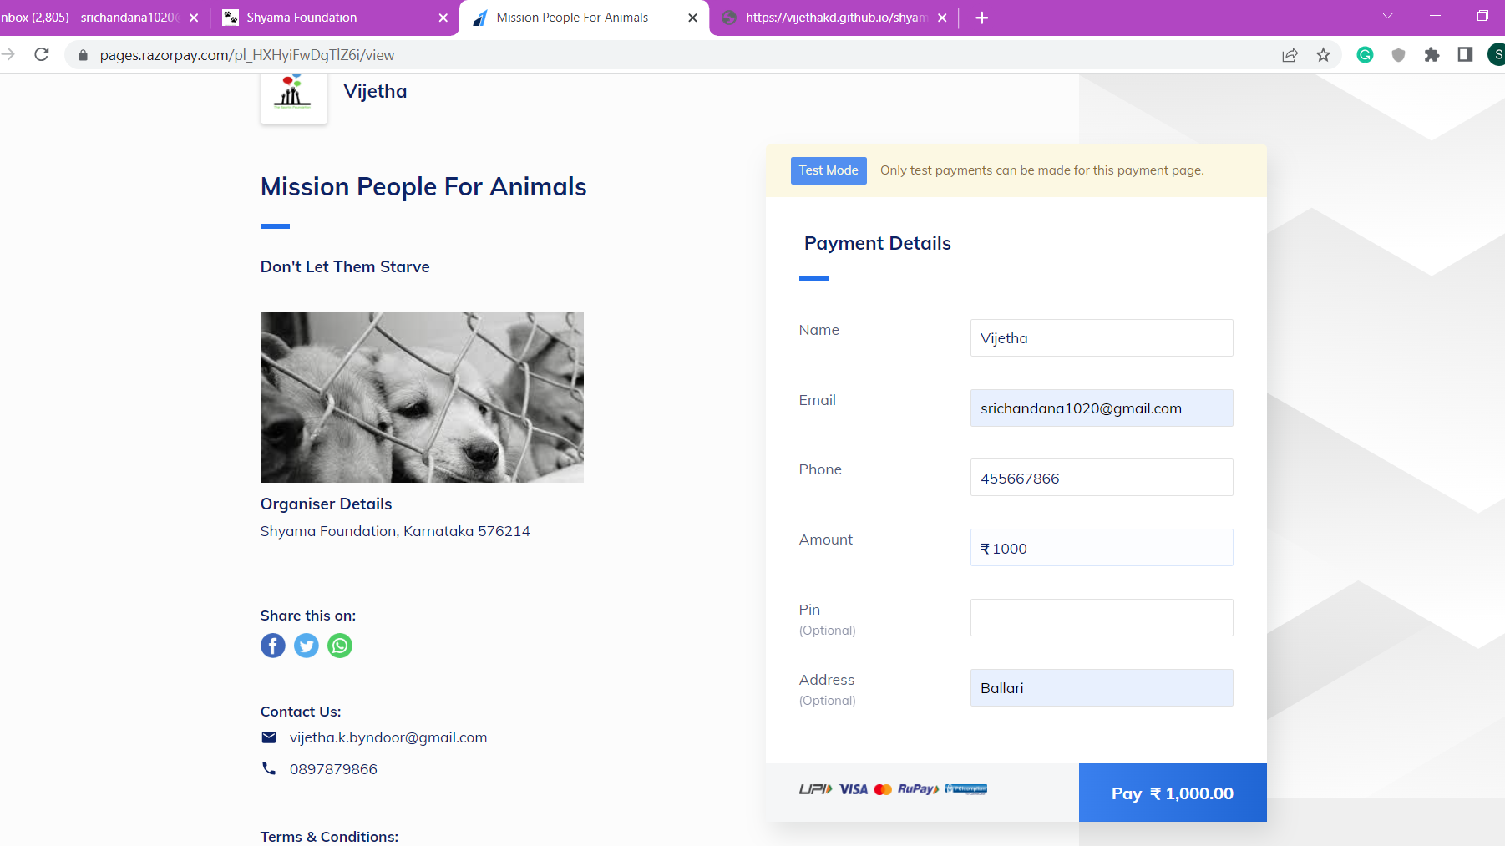
SNAPSHOTS

Slide 14
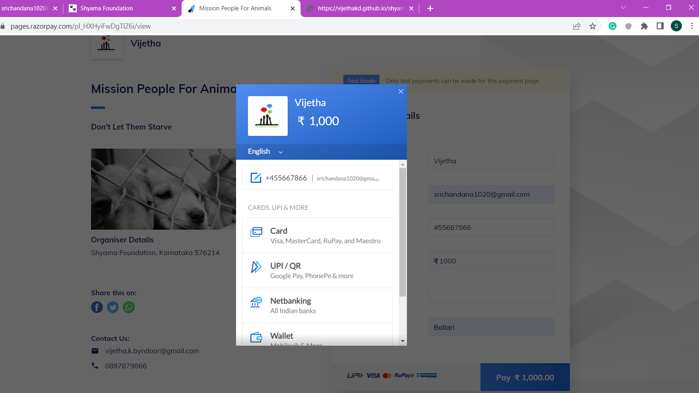
SNAPSHOTS

Slide 15
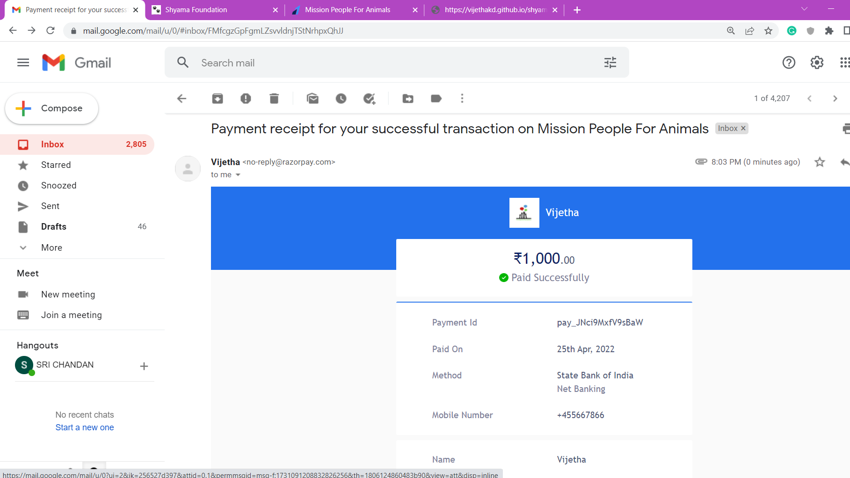
SNAPSHOTS

Slide 16
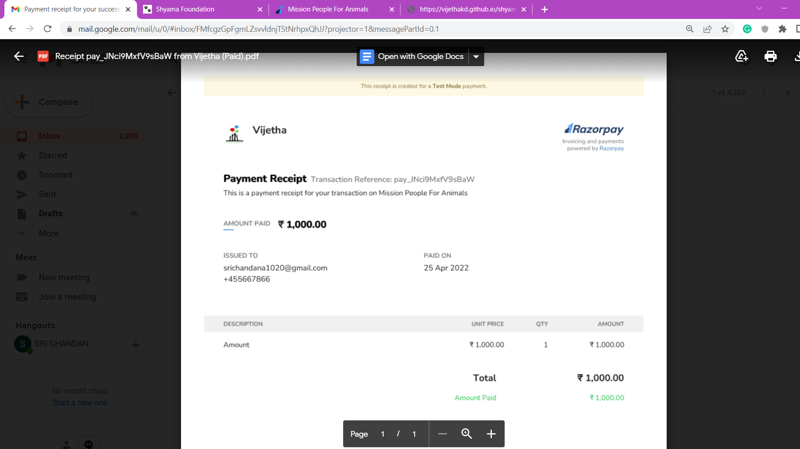
SNAPSHOTS

Slide 17
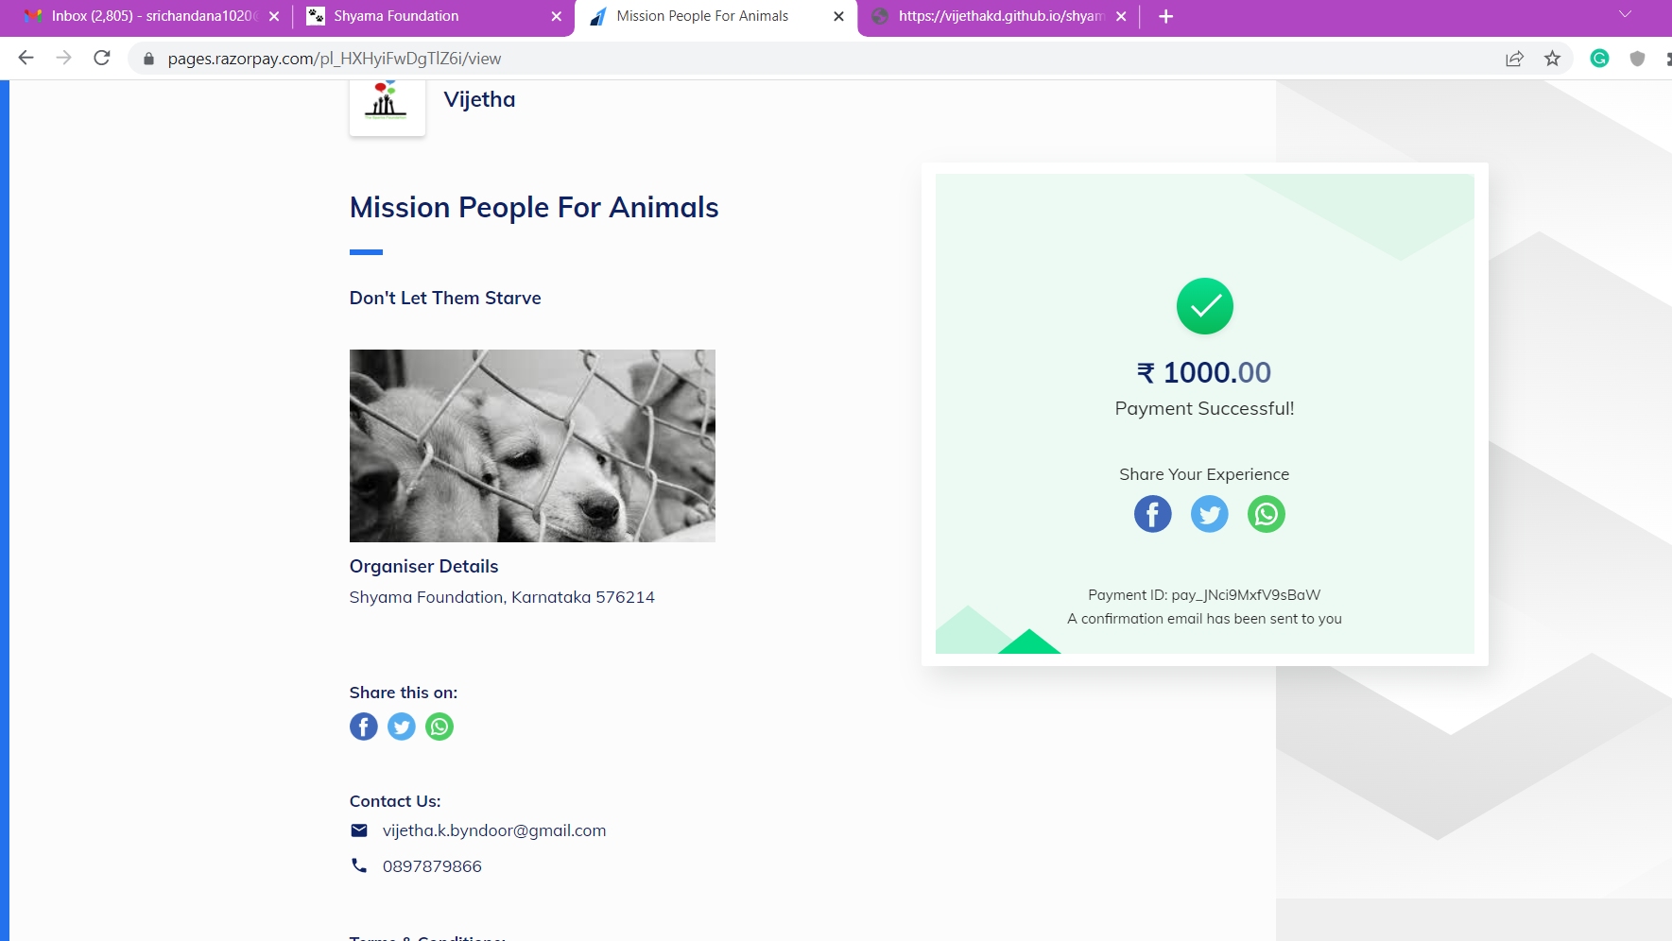
SNAPSHOTS

Slide 18
CONCLUSION
Improve both personal and professional skill
Communicating efficiently in a team.
Encouraged me to pursue HTML, CSS, and JavaScript.

Slide 19
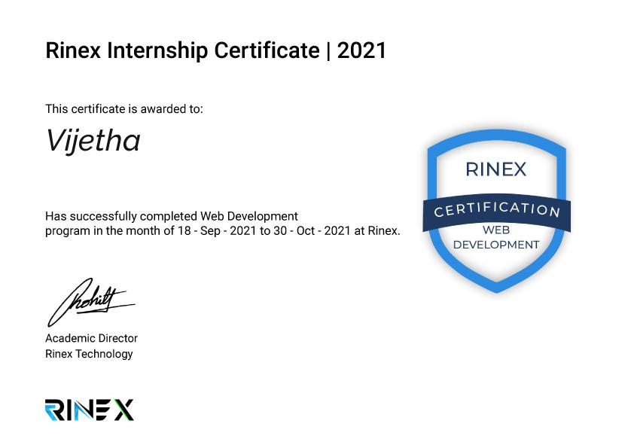

Slide 20
Thank you.

